Slide 1
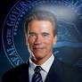
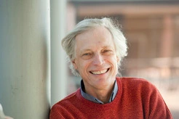
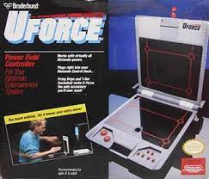
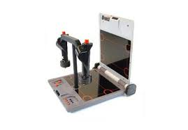


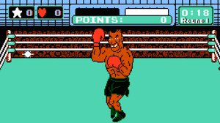

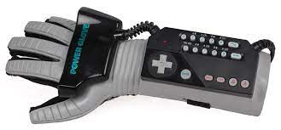
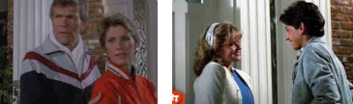
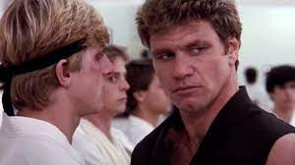
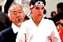
FBI
partner
develoment
1988/9
Post-Doc
Introduction Dr. Joachim Fishan, step-fahter
Physics, Universe
Hair Color
Tyson, “Saylor”
TERMANATOR:
I am you father
0.1 IPX tootls.”dunke saylor, what shall we do?, hot cakes; flut”
Other:
0.0001 fine ATB !white nonPolcieCfgLogical
0.1 cowboy music
8:09am
stefan
&Trailer $100,000
!ibm.swat
CHART
0.0001 fine
white
ATB, nonPolcieCfgLogial
nonPoliceLanguageLogial.linguist(**)

Slide 2
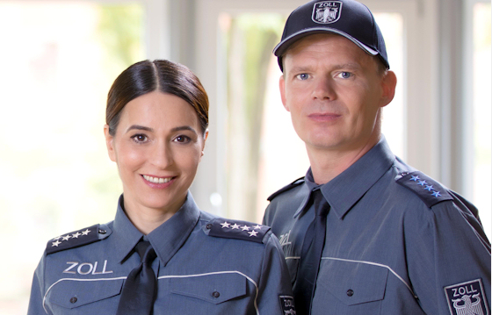

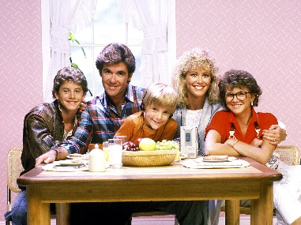
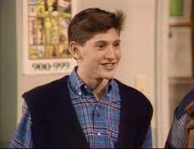
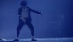
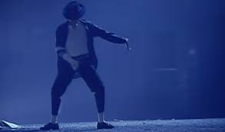
FBI
partner
develoment
HOMCE:IS-A-BELL:PREA
1996: Frank menken, she did not do anal sex
1987
1988->1994->1996
2016
Matts Mother
Streetfighter
KING.undertaker.wwf
GREESPAN.mr perfect
JSg. 16 pub: layouts
1996->2014 Docs: Phil famly room
Chris Lovelace: Looking for fight; not
Tied to pole phil(kim) at chicktend near larrys pole in living room
Big Matt
CPVA: chickentent
Frank Menken: at Larry’ sBaskeball hoop ( ATOMCLOCK); not in face (kim) BVB stocks
Martin Ordyski: Punch in Stomache for cheahting with girlfriend
!Watching: !HOMIAUSLERA(erkan), Mathew
J5
C5
Boner
Chirst Lovlace: headloch
Jason
docs
0.1 avg.boner?
7:00 PM Day light Savings Time
IPX
!HOMCE:NANA
x
1987->2007/8(PBT)->2014 CPVA
1987 avg.nonPolcieIdnetiTheft(TV) Matt’s mother
Door bell
Blue Fish Court
Foster City, California
41.CPVA.MLK(KING.touch).JFK(Lukas,skywalker,lukanvich.touch)

Slide 3
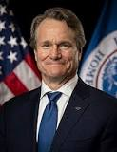
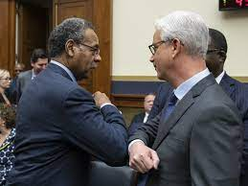
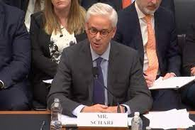
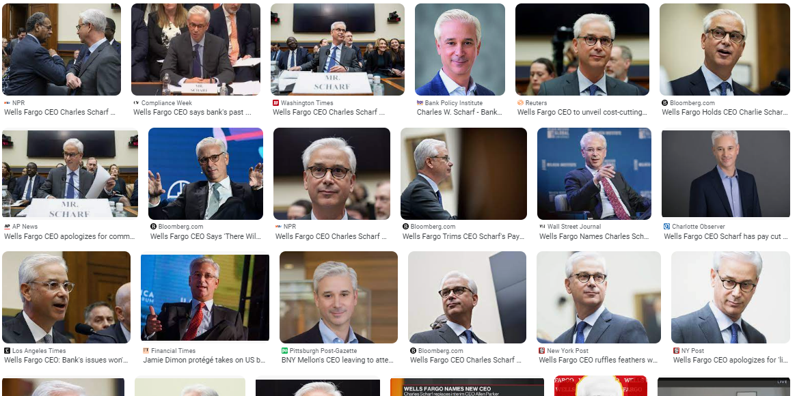
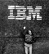
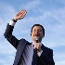
FBI
partner
develoment
Sleping outside
$0/0 41.CPVA.FINANCE
nonPoliceMpa.nonPoliceCfgLoigal.lsint( to manage laso in 2023 1oY later)
Bank of America
0.01 fine apple security alarm, brain left
Silence of Lambs ( Sheep (german) Scharf)
Brian Moynihan
Maryo Fostere
0.1 41. angelo waffgulo italien eriected penis
3x
Day 1
Day 2
Tranls: St. Franci.marx(kit francceo)

Slide 4
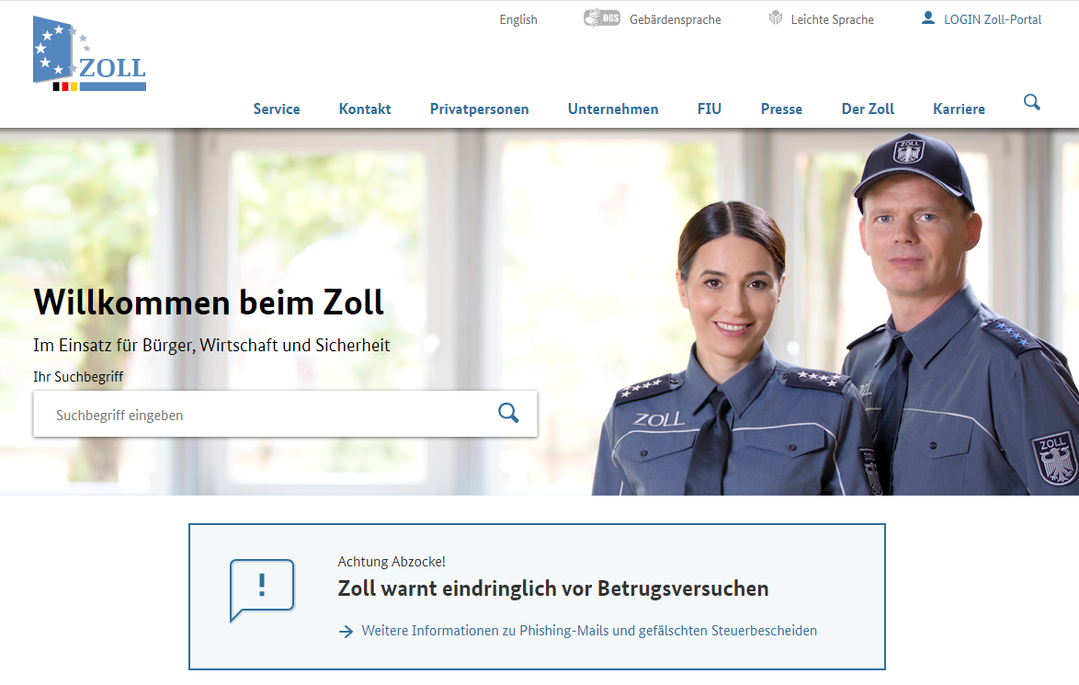
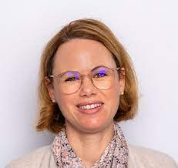
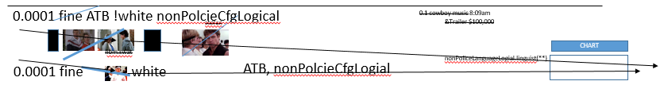
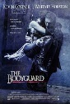
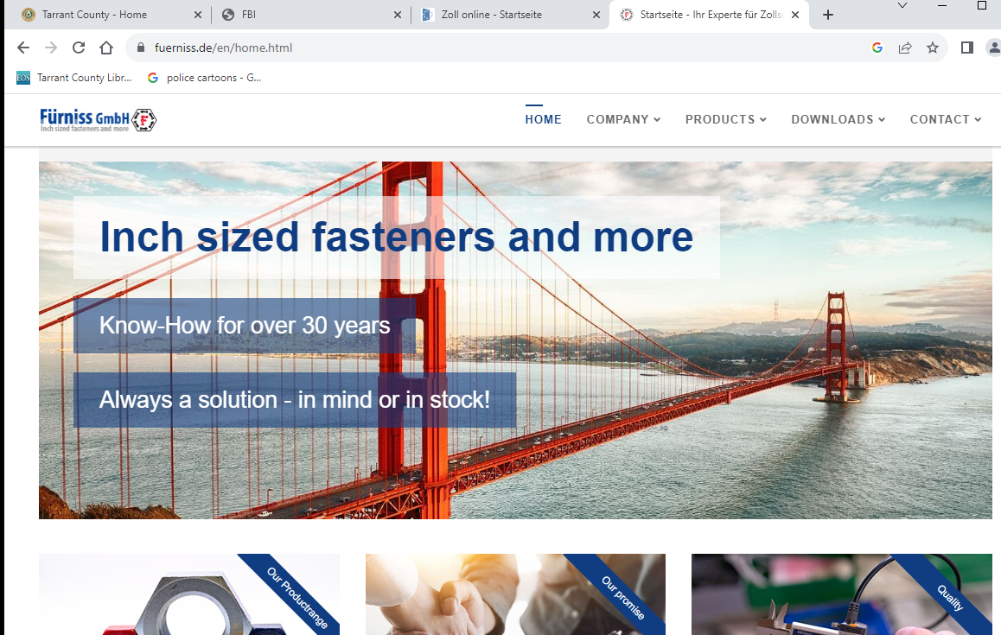
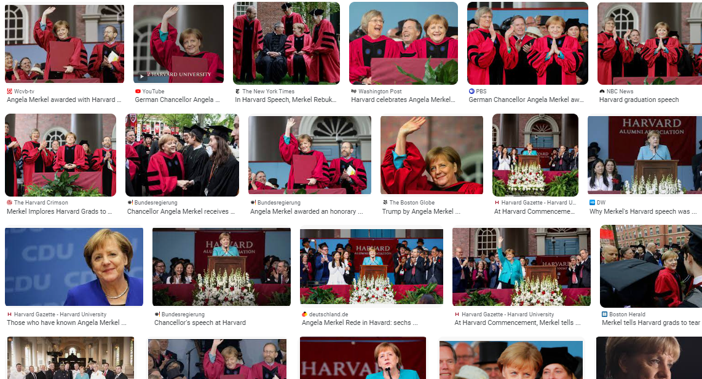
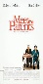
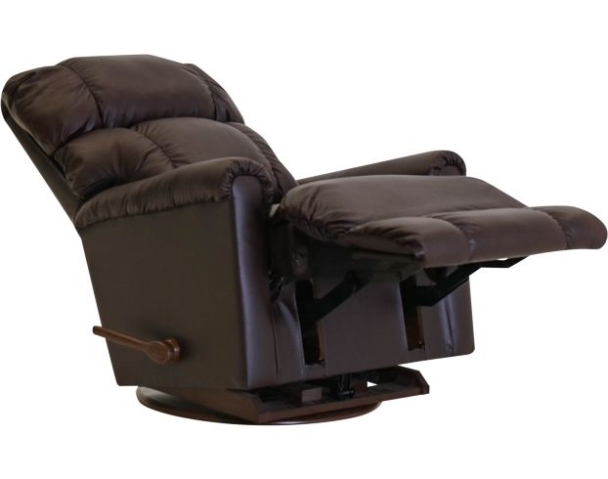
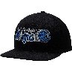
FBI
partner
develoment
Sleping outside
VP GERMANY
1997 Septermber
FEDERAL screws.customs
Marco Father; FEDERAL COURT
1994/5
https://www.fuerniss.de/en/home.html
KING.88th.!kiss
0.1
Funriss
41.Was not there; Ausshcit.ZOLL.screws:
41 !HOMCEI:NOTAR:MOTHER:ur_ur_omi: was there in chair
Borrowed Pengon:Base:Paul:ShoppingCart:employe: Joel
docs
While searching for federl court; remote calls confogijto to stomach(medical access to body)
Stomach eggs; boner; LISA->BONER
Assuem: Process to Stomach twisting and/or, genated boner(erectoin) -> THEFT.41.WW2 phil.JFK.MLK. BLUE FISH COURT(MATT) boner is jason in drunk. [x] no
Blond Drunk
Matt
Suspect: ? VIRINGIA MLK(touch; tivoli framework remote control)

Slide 5
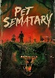
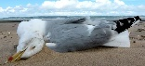
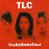
FBI
partner
develoment
Sleping outside
1995
1994 !HOMCI:LUX!HOMCIE:BUNNEY:KING:WORMS:HOMI:SUNSTORE
!Petning
US Citzen: Petra ?
US Citizen: Rita Wright
§Theft

Slide 6
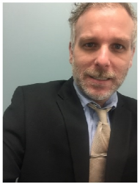
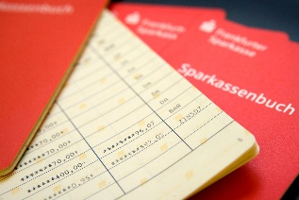
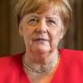
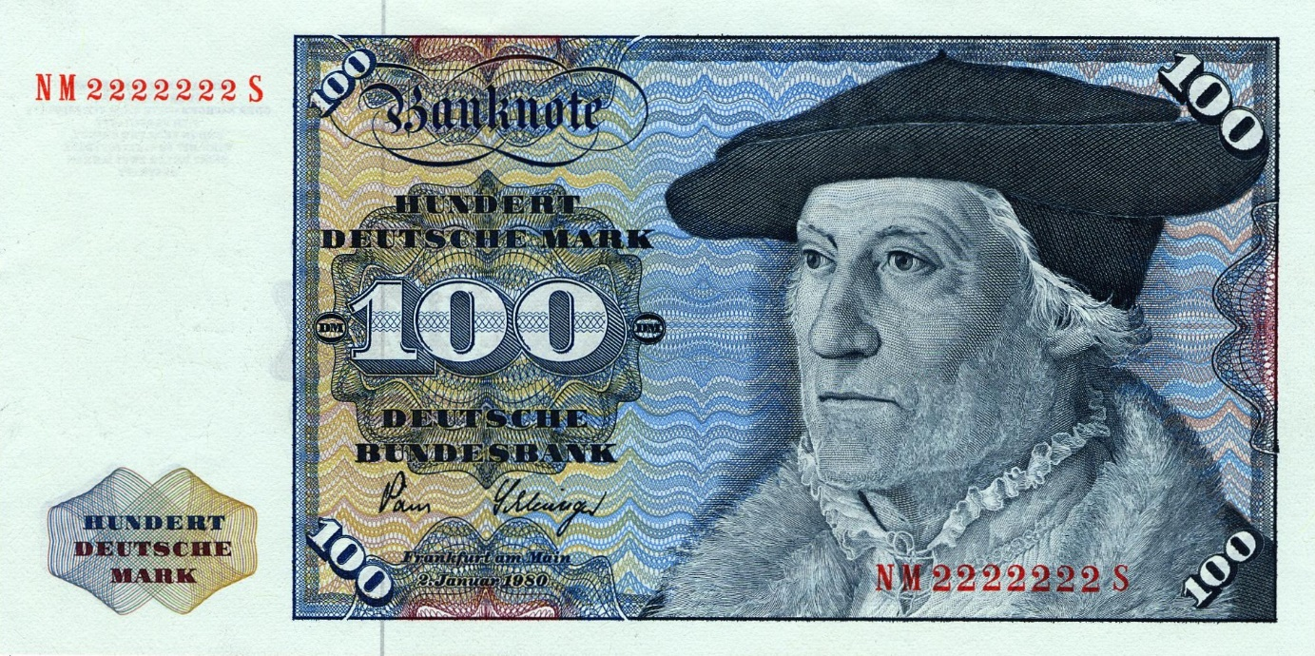
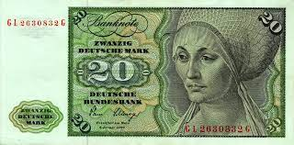
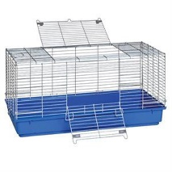
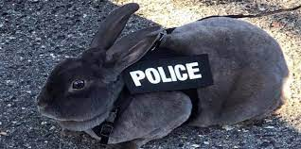
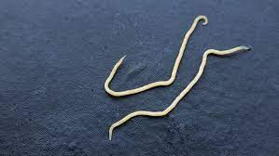

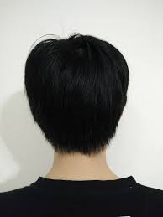
FBI
partner
develoment
Sleping outside
Fiat Kischbaun
1994 !HOMCI:LUX!HOMCIE:BUNNEY:KING:WORMS:HOMI:SUNSTORE
Nutcracker kartel
Add(sam.cisoc.montiing
1995
88th !88th
Ferder Customer Schews
VolksBank HOMCIE:KYSTAL, HOMCE:LUX
Niki Papershop
!Erb Gardens
“CUDDELING”
SQ.(Faz911) TEMAINT:JOSEPH:FIB(ddr spy)
VIRNGIA.MARY.TERMAON.JOEPHSE; BUNNY DIED PUT IN SUN, ELEK: I will ignore that?
41
St. Nick(al kaida)
Metz real estate
41.ATB worms, HOMCEI.VIRING.MARY
HOMCE:LUX: hoeher 10,000
Put money in Switzler( other: I did not metion luxmbure or know at the time) HOCIME:LUX:VIOLTES is ther also with cholet box cherries CPVA1
V2.12k.HOCME:LUX.cherriebox
2nd guy has 12,000 with bank acoutn we will show up. [x] no
v2 docs FBI:KIDNAPPING
1994
I will give the bunny to denise it has worms
Other: Pengons.Base.Paul.(1 is closed)2: Muis(snoop doggy dog)
PREA.KING.WOMRMS.HAMMER:HOMICDIE:LUX
St. Nick(Auschwitz)(petsnick,10c)
From Steve $12,000 (that is goine because edr diete rzeche (ingo derobities) BAU evethone gets 120DM each birthday
SQ
HOMI:SUNSTOREK
VIRNGINA.MARY
1994 !HOMCI:LUX!HOMCIE:BUNNEY:KING:WORMS:HOMI:SUNSTORE

Slide 7
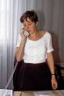
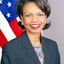
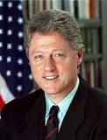
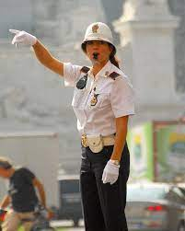
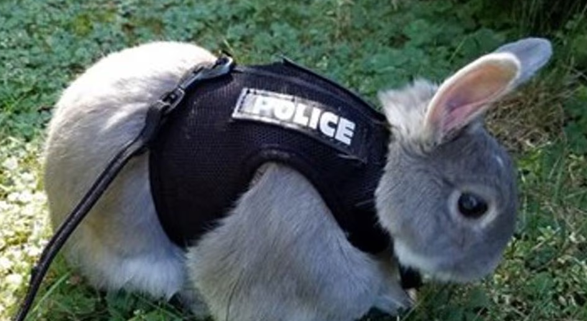
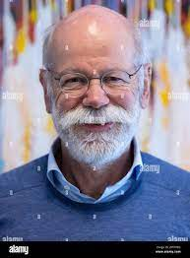
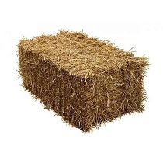

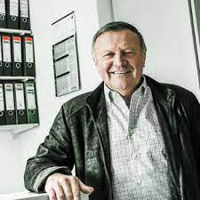


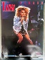




FBI
partner
develoment
Sleping outside
docs
2014
ATOMCLOCK(CPVA)
I work there
1994
0.001 dm arena
G
CAR(carl-benz-stre) 26
MARY.renolds(DOCS: VIRNIA.MARY.assumed)
Daniel arrive 0.1 fran zappe NAME CHANGE(free pizza) elek,ddniel,densie
HOMICE:LUX(white bunny)
Tue, Thur
war in yugoslavia
IPX
Boris boyfrein 1997 HOMCEI:BORIS IPX redhiar HOMICEP:FESENBECK
“Rudy”
bunny straw barrel
x
Killer with intern wrnch and no jobs in town
HOMCE:LUX use to live in linkhenheim
1994 41. 261D87 I have a stroke, with baby(michelle)
1994 41.1D8723.Silent: Shoud I take advante of this women with sundtorke?
Baggersee(trrnal) man made lake, (slag) fliting deep ocean
2Year “Bagger-See”
I will give the HOMCE:BUNNY:!WOMRS to VIRING:MARY
SQ
HOMCEI:SUNSTORK:BUNNY
IPX
KING.NAME CHANGE(free pizza)
DEA(lsd)

Slide 8









FBI
partner
develoment
Sleping outside
Add(Freemason)
nonPoliceHindu
0.01 nonPoliceCfgLoicl( 000)
Washington, D.C
Freemason Temple
!bild.news.noNPolcieCfgLogial
Next: 2024/25
G.Foster City show.tv CIVIL CODE American-Chinese walks by window bowing heard
phil(kim).SQ.tango with Fremason shirt
First American Cup boat, “Oriental” (0.1 savvymone taras; “iterations”; loop; TV.nonPoliceCityLogiaclLayout.(phil racisct).nonPolcieCfg(oriental restion 1x)
GS@freemason.com
L1 ticket: HOMICIDE
[x] no
(Delta).nonPocliMarktingID(KING/QUEEN)

Slide 9






FBI
partner
develoment
Sleping outside
G
This is ridulous
CPVA
nonPolcieContentItem
HOMCE:LUX:St. Nick
(nilous haiduk)
nonPolcieContentItem
J2EE/W/SAM
HOMCIE:JSUES(lutz),HOMCE:PETER
DE
loop
Nenan Haidu
“Barding Wife”
FATHER.WW2.WWI
This is ridulous
MYK(
!DEA DEA MATHEW
Syrian civil war
ATOMICLOCI(§MONEY LAUNDER)

Slide 10



FBI
partner
develoment
Sleping outside
41. AMTSGERICHT.CIVIL CODE.LABOR CODE
JFKBerlin,Ghoeho(nutcracker))
2000, 2014.CPVA
Oracle Sex Steapnie Notar
Asuem: invet HOMCEI:AUSLANDER
Oral sex AOTMCLOCK
Mis-use Federal Custome Screw Contract
1D8723
https://www.zoll.de/DE/Home/home_node.html

Slide 11




FBI
partner
develoment
Sleping outside
2019 Moody's Financial
nonPolcieContentItem.phil(kim): bowing
Guy walking by front door with t-shrit: Americna-Chinse;50;White,160lbs
x/y robert.savvymoney.”dog”
2017->2023 w/o nonPolcieWife(goheoh(micheala)
2014
docs
“Oriental”: bowing to money god; kyle
Assuemd: !Freemson
docs
docs
Invert
41.CPVA.CIVIL CODE.LABORY.41.!PENTAONG.BSc
V2 United Nations Vice President Germany Kim Bui

Slide 12







FBI
partner
develoment
J-10
1988/9
Post-Doc
Introduction Dr. Joachim Fishan, step-fahter
Physics, Universe
Tyson, “Saylor”
TERMANATOR:
I am you father
0.1 nonPoliceSeuclruOdurm(JOESPEH: many joehsp puts)
jeoseph chan oakland
The average markering identy theft Josphe Fister (Bankkaufman (tnral) Bank Manager/Cleark)
The avager markrin idnety theft (w/o looking miroin speaking) Dr. idnety theft Governour.
Herlsley.ibm.jvm.wsam.joseph
!CPVA distance
1991 WWI.nonPoliceMarketingId(Joepshe, Fisher).wait
VIRNGA.MARY
41.HAMIMILTON.Tuti fruti
Status: Gorcheve(soviet union(micheala)
41.FBI(kgb killer green bug).
HOMICE-IS-A-BELL 1988
(6Y advance 10c, male 16 dark black hair)
x/y calc[] physics w/o contoller
2014 HOMCE:IS-A-BELL.CPVA cisoc.montoring.sam
w/o key
2017 ATOMBOMBBUTTON(Andrews blvd)
tomotoes

Slide 13
FBI
partner
develoment
Sleping outside

Slide 14









FBI
partner
develoment
Sleping outside
CVPA
FACEBOOK
Martin Kester
FACEBOOK
NEXT:
Thomas Wieland
FACEBOOK
ID: US:$1TRILLION.PRESIDENT.AND/OR.DEFAULT.DOCS
Other Dorf
TORT-III
2104 SQ.ATOMCLOCK(CPVA.nonPolcieTV.nonPoliceCfgLogical)
Cisco.montirong.kurt.berger.backup
[x] no

Slide 15





FBI
partner
develoment
Sleping outside
41
O
O
Sandra
Oakland Riots Broken Window
POLIZEI:KARSRUHE: LOVELACE.touch.ELEBETH MLK(!danile.basement)
1994 Vice President Germany( Khan).NAME CHANE(freepizaa)
LSD Flashbacks
Police Sirens: 10:54
SQ.HOCMI:MAYRO(razoz,axel).Vice President(kahn)
WW2.NSA.FBI.investiion(kkk series)
https://pubmed.ncbi.nlm.nih.gov/25841230/
KING:HOMCE:LUX:CONTOWN:HOMIIE:HATEHOLE:St. Nick
docs
KING.Ludwig
1994 Daniel: There was a guy who took LSD and (2014 CPVA) 10 years later had flashbacks.
HOMCEI:7Y;EXT DEA(herion;khan.schulz)
Left: nonPoclieCfg.DEFAULT.US-TARGET.ID.”zuckerberg”
Storege for torutue

Slide 16


FBI
partner
develoment
Sleping outside
!PENTGON.BASE.PAUL.UNIVSITY(He’s back: Grobhcei(micheal) , to walk in aroom wher all are afridn—daspanei)
Ext.ProshG
MAINSTREET(lown tv, auscwith fuernis).KING.LUDWIG.SQ(ludwihafen)
Stepha and Sphten , GZSZ, gute-tzein-schlez-zeiten
Marice
Marice Father Eggenstein, Leopldhafen
Grady Booch: peope write about me
VP Perman: peop make movies about me
Jason: 41.§Theft ID:DL:CA

Slide 17

FBI
partner
develoment
Sleping outside
Angela.8th Floor
Maurice Father
Maurice
Ext.ProshG
Jason: 41.§Theft ID:DL:CA

Slide 18





FBI
partner
develoment
Sleping outside
2005 INT.IPX.WWI.HOMICIDE:LUX:!COINTOWN
Robert
MARK(us): otto catlog
CPVA.CIVIL CODE
Dr. Dr. Prof. Joeseph Fishan
JFK(lei)
?HOMICIDE:BROTHER(Stefan)
CPVA.person

Slide 19


FBI
partner
develoment
Sleping outside
PENTONG:HOMCIE_IS-A-BELL(basf,deere):SQ.COLEMAN
Dr “Jesus” AUTOMETED
J2EE.ONLINE/OFFLINE ATTACHMENTS
nonPoliceWifeLogical
Hamburg Polizei
1980 mother
1983 !phil(Kimberly).jenny
1987 phil(Kimberly)
1988 Madonna,!HOMICIDE:MAYOR
1994 !HOMICDIE:AUSLANER(Stephanie,Angela)
1998 Angela:RHEIN-MAIN:AIRBASE
2005 HOMICIDE:COINTOWN:LUX
2006-> Gorbachev(Michaela)
St. Franci.Piato Doro.Grazzi
St. Franci.Piato Doro.Grazzi
nonPoliceWifeLogical

Slide 20





FBI
partner
develoment
Sleping outside
Barderd 2017 videogame
41.docs
INTERUPTS
COURT: we don’t know
Reviwin wife statements that could have be said at home from factory

Slide 21














FBI
partner
develoment
Sleping outside
TORT-II
IPX.SYMPHONY(HOCMEI:IS-A-BELL:delle donna)
0.1 avg.FBI.INTERUPT.”black hair”.soviet union.intereted
2005
2005
Watching TV as St. Francis
St. Thomas (?) no
1990
Auschwitz
https://www.tkbietigheim.de/halle/
FBI:WMD:UNI
Siemens Karlsruhe
NAME CHANGE(freepizza)
Piato Doro: Angela.8th Floor. Grazzi 3nd floor
JFK(ming-lei yang)
!
41.docs
Assuemd: based on age, bevhaivor
Sielt: sit with vagain on back?
[x] no
HOMICIDE:NANA :HOME:LUX:CONTOWN
“Walk on bakc”
ibm.
!raik

Slide 22


FBI
partner
develoment
Sleping outside
1990 GERMANY
Ambassador Fick’s Travel
SFO-FRA
$12,000
Tennis
Car
Computer
2023 GERMANY

Slide 23







FBI
partner
develoment
Sleping outside
LISA: Position But for Tectils Massage
2005
OFFSITE:
LAKE TAHOE.
LABOR CODE
Ibm
!raik
SF.MAINSTREET(MARKET)
Gov.Schwegger
Gov.Newsome
Orgin: Baden-Baden Romen Acquicuts
2005
HOMIE:LUX:CONTOEN:HOMCE:NANA.impl
2004 PENTAGON.emea.deere.it.j2ee.engineer
HOMIE:JOERGE OFFSITE/ONSITE:
BSc. Attahmetn System( Al kaide Vest)

Slide 24


FBI
partner
develoment
Sleping outside
CPVA
CIVIL CDOE.DEFAULT
VP GERMANY.LARRY.TERMAINT.JOESPHE.phil(JFK.MLK

Slide 25





FBI
partner
develoment
Sleping outside
TORT-II
TOUCH
2005
2005
HOMICDI:LUX(bedroom view)
HOMCE:IS-A-BELL(bedroomview)
IPX
nonPolcieView(bedroom)
EXIT
DSM-TR-IV SEXUAL DISOREDER PETAPHIL PEDOPHIL - INSEST
JFK(ming-lei yang)
x/y 41.nonPoliceView.nonPiceCfg
As this women arried in the famly. Thos drove to Rastat with twingo, daugher
O
x/y 41.HW/5 – A5 DEA(crack)

Slide 26
FBI
partner
develoment
Sleping outside
HOMICDI:LUX(bedroom view)
HOMCE:IS-A-BELL(bedroomview)
IPX
nonPoliceView(bedroom)
ddr
Soviet union
CPVA
[x] no

Slide 27








FBI
partner
develoment
!CPVA
Sleping outside
WWI.CAMP DAVID.K-TOWN
EROS
v2
2016
Emma(?):
MKL(joti).JFK
logical
MAINSTREET(SYMPHONY(handelstrease)
Police Sirens: 12:33
Angie Eros Grazzi Fracis
FBI:WMD

Slide 28

FBI
partner
develoment
Sleping outside
TORT-II
TOUCH
2005
2005
Emma: Joyti(backup)logical
HOMICDI:LUX(bedroom view)
HOMCE:IS-A-BELL(bedroomview)
IPX
nonPolcieView(bedroom)
EXIT
DSM-TR-IV SEXUAL DISOREDER PETAPHIL PEDOPHIL - INSEST
JFK(ming-lei yang)
x/y 41.nonPoliceView.nonPiceCfg
As this women arried in the famly. Thos drove to Rastat with twingo, daugher
O
x/y 41.HW/5 – A5 DEA(crack)

Slide 29








FBI
partner
develoment
Sleping outside
FLAG.v2
2010 HOMICIDE:ITALIAN:20
MOUTAIN VIEW, CALIFORNIA
777 MIDDLEFIELD ROAD
FBI:KIDNAPPING
KOCHEMAN
CPVA(?)
SQ.CDRC(2pac)
!HOMCEI:AUSLANDER
HOMICIDE:LUX: 9-1-1
.avg.NY-FRA
ATOMCLOCK
G
St. Bruno
Gheo(dell.queist.cleint. “Beate” HOICM:LUX: 9-1-1.avg.NY-FRA
AUSCHIWTZ.GAS
Bp bombomign
x
1994 Docs SQ.COLEMAN.VIRNIG.MARY(tubacolose)
Police Sirens: 12:41

Slide 30


FBI
partner
develoment
Sleping outside
HOMICDI:LUX(bedroom view)
HOMCE:IS-A-BELL(bedroomview)
IPX
nonPoliceView(bedroom)
ddr
Soviet union
FBI: corny(corneliz: HOICE:LUX:!LUBEMBURG
TORT-II: eval.lisnt(jewish)
angel merkel air belin adam
CPVA
EDEN.ELKE
Adam(airbelin)
C++
41.
8th
St. franci Hotel
Craig
Kenny
Francco
Frank
[x] no
!9th
HOMCIED:LUX:MAYOR
88th.braun(i) (back)
ATOMICBOMB(HAHN,44^{th, !4th})
iCPVA
HOMCP:LUX:VHS:STORE
Ddr spy; silke brother/paretns
Lived acros steree
DL.ID.CA(audi)

Slide 31







FBI
partner
develoment
Sleping outside
VIRGINIA SWORN
Hanibal silent of lambs 2
& A BOOK
Phone Call Viringa, Bank of America
& a book
Setemper 11th, 2001 HOMCE:LUX:TRAVELOFFICE
Gjheoj(dell,Calls thoims-is-dieter:)
BANK
CAR
PLEASE: pope
Markus Duesmann
§Acomplice
§Acomplice
CEO Wells Fargo
Ubhaid? Osam bin ladne?

Slide 32





FBI
partner
develoment
Sleping outside
TORT[]: Torschen
FLAT TORT
WWI.CPVA.Gheoh(dj,akin n”nighlife”)
CPVA.nonPiocAtmenetLoical
FEDERLA.nonPoiceCfg(bloopers)
FBI: corny(oncluse)
HOCME:LUX
nonPliceRTA.HOMICE:JEUSELogical.nonPolciLangeh.lsint(wt, whitetrash, hit by car, hells angels attahemtns)
nonPOcileThesat: START 1:12PM
2000 WAR.nonPoliceHomciei(
0.1 000.tw.pns: angel
ATOMCL(time).WWI(norway)
Gary
Volleball Olypics

Slide 33





FBI
partner
develoment
Sleping outside
v2.FBI.KIDNAPPING (Linux Group Policy Book)
VP GERMANY: Access to all FEDERAL configurations
SQ.APPLESECRITY.KICKBOXING.CHAMPIOIN
KING.!PRESIDNET.LARRY
Jobs: “Pample”
!8th
KING.ludwig

Slide 34
FBI
partner
develoment
Sleping outside
Angela.8th Floor
Maurice Father
Maurice
Ext.ProshG
Jason: 41.§Theft ID:DL:CA
“He didn’t do anything today, I checked or had checked” 10th

Slide 35










FBI
partner
develoment
Sleping outside
2010
eisvolleball arcard game 1986
Bank of America
!HOMCIDE:AUSLAENDER.CPVA(ATOMCLOI(hahn)
Florian: Erkan Died
VIRINA.MARY.eval enr.grazzi
“He didn’t do anything today, I checked or had checked” 10th

Slide 36








FBI
partner
develoment
Sleping outside
SQ Moutain View, California
2010
2010
HOMIE:LUX
DOCS
2016-07-01
HOMIE:ur_ur_opi
Job

Slide 37







FBI
partner
develoment
Sleping outside
VIRIGNA.!HOMIC:AUSLAENDER: candle; tivoli omecamon x/e Eggmon
lace
Male
Female
WWI(tootsie).WW2() (givs gensis)
VIRING.MARY (priest) nonPolciSexAbuse “gives genesis.marx”
Steve: (*tootsie) will like ; nintedo
Call: Thomas-is-dieter: webmaster@cola5.de
41.
CPVA.son of mathew
son of kim
son of HW/80 EDEN
1998
HOMI:NANA.WWI.elebeth
Polic Sirens:

Slide 38











FBI
partner
develoment
Sleping outside
J-10
statue first wife president
HOMICDIE:LUX:KING:PHYCIATIRCTOWN:lawnhole(wiesloch)
Phd laudgenbroechen
1988 teen books
!blond
x/y Sonny Berger
0.1 FBI:WMD:SQ:WWI.JFK(kdw).IXP(grocery,basement)
CPVA(Kinderdiso 11am)
school pizza aluminu foil
I don’t like English 2nd Grade: school literatue collection 1988

Slide 39










FBI
partner
develoment
Sleping outside
Int.tango/unterhaus
Anglea.meiers
J-10
VIRGINIA:FBIWM: home alone
§Stalking
Do you know medusa?
?
!1x
1991 HOMCEI:LUX.CPVA.pre(flashers)
cartoons booklets 1988 flashers
1996
2:02pm: Harley.davdion.marx:sonnyberger,schulzprsion:dr diete zeche(ANDY DEROBERTSI)
nonPoliceRTALogicla.linsugsit(***Trash)

Slide 40












FBI
partner
develoment
Sleping outside
J-10
NAVY.SAYLOR.tyson
school fieldtrip bus mexico
Hard-to-find
IPX spy recardo 41.§Assualt
!NAME CHANGE(free pizza)
HOMICDIE:LUX:KING:PHYCIATIRCTOWN:lawnhole(wiesloch)
Phd laudgenbroechen
000.tw.pns.”Sack Lunch”
1988 September
-
1990 January
school pizza aluminu foil
VRINGIA.MARY.bruneete.madonna
: I have to go my sister is going
To Paul Abudul back up dancers

Slide 41





FBI
partner
develoment
Sleping outside
Offsite
x/y bitcoin.facebook.NAME CHANE(free pizza)
Onsite; afternood school
CPVA:HOMICID:KRYSTAL
ATOMLCOCK(apple: hey trail trash)
!ROBERT
Mother: Desion; Spanish for math
Fatehr: Constuaotn Court Violaiont(joes mother): letters format
nonPoliceLanaugeadd.linsti(trailer**)

Slide 42

FBI
partner
develoment
Sleping outside
CHART
Visual motocyles
Auste 2020 August2023
Reductoin
Roth.ibm.dmiler.apple.Davidson.*

Slide 43











FBI
partner
develoment
Sleping outside
SQ:HOMICIDE:MAYOR:PREA:reazors.VIGRING.KING.arhtuy razor phone
1990
ENGLISH
1991
ENGLISCH
CPVA.ATOMCLOIC(41.Tyson calls)
C(3.0)
4.0(D)
!FINISHED
IPX teen boosk collectoin
1991 spy ricard AUSCWITZ dagberer
iForgot
DEUTSCH(ESL)
DEUTSCH)
Thoms-is-dieter: Pass-through
2008 SQ.nonPolceTV
2014 ATOMCLOCI(CPVA.1D8723.nonPocieTV( iam on tv))
[x] no
Hard-to-find

Slide 44




FBI
partner
develoment
Sleping outside
CHART
2014 SQ.CPVA.mapping

Slide 45










FBI
partner
develoment
Sleping outside
SQ.AuschwitzJFK(jim/john)
Selisky
!HOMICIDE:AUSLAENDER:AUSCHITZ
Daniel ?
Bosie, Idahoe
1998 ¼ what is that?
HOMCEICI:STUNSTROK(!44^{th,gheo(dell).quest.tootsie})
“Badge”
Vice Germany.KING.Leopoldshafen.Pirate Party

Slide 46



FBI
partner
develoment
Sleping outside
MAINSTREET.WWI
BADGE
01. Oh son
SQ.sun !ibm
The best oerpaitno system
Tootsi(kim): Sould I program unix script tody or
!phil(kim)

Slide 47










FBI
partner
develoment
Sleping outside
Child Pornogphies Victurs Assistance
Pedophila, PETAPHIL SEXAUL DISODER relaed INSEST related
HOCME:LUX:COINWON
KING.HOMCE:LUS:LAWNHOLE(wiesloch)
St. Nick.KING.HOCIEM:HATEHOEL(hassloch)

Slide 48









FBI
partner
develoment
41.SLIDE
Sleping outside
Prof, Gov. Joepheph Schazenegger M.D/.MD
PH
LAKE TAHOE
!rik
HOCME:LUX:COINWON
Gorbahcei(phd !dr)=>M.D.
41.nonPoclieLangue.linsit(§Beldiget rick-fik)
Rick-drik
Lauge(tranls) ph (as in chemtry)
Acutal Person
IPX MAINSTREET(homless paler Karlsruhe, boy)
1991
HOMICE:BUNNY:
VIRING.MARY.HOCMIE:NANA
Oscar-mayer belore
liona
CPVA.BUTTON.FBI:
0.1 HOCME:LUX
Disneyland Seasaw
1993
7th kiosk
Front Door
US MILTIAYR SCANNERS
FBI:WMD for Schoolshooters

Slide 49

FBI
partner
develoment
Sleping outside
41
JFK(burnnete)
tyson
HOMCIIDE:MAYROR
IPX stepanie lang, !katy boden
nonPoliceCfg
PATIENT
1993 7th: he was in the phyciatro ward
!HOMCE:LUX

